Slide 1



STEPS TO BECOMING
A PRO GAME PLAYER
A BASIC GUIDE FOR BEGINNERS

Slide 2




GAMING IS THE PEAK OF CREATIVITY
It's not easy to become a pro player but it is possible

Slide 3


CIA RODRIGUEZ
TECH WRITER AND PRO GAME PLAYER
BACKGROUND
Eleanor writes for a tech blog and runs a personal gaming channel. He was also a professional gamer for Fradel E-Sport
BEST ACHIEVEMENTS
His career-high for kills in a single game is 25. He achieved this feat while playing for Aldenaire Game

Slide 4


STEP 01
FIND THE REASON WHY
It's not simple to be a Pro Gammer. Dedication of time and thought is necessary. You must know the exact reason why you choose the professional path. because when you become a professional player, games are no longer just entertainment

Slide 5

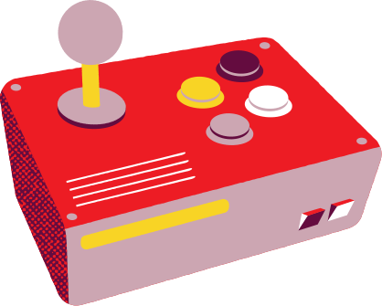
STEP 02
PICK YOUR GAME AND ROLE
The next step selects the game. There are two schools of thought here. You can pick a game that is currently popular or follow an established game. This process is important to find your role in the team

Slide 6

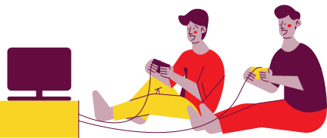
STEP 03
JOIN THE COMMUNITY
Join the community so you can get lots of insights. It can also develop skills and characters in the community

Slide 7

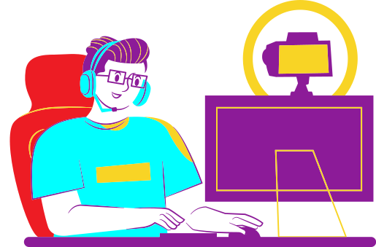
STEP 04
PRACTICE MAKES IT PERFECT
First, master the game’s mechanics. Concentrate on learning game-specific skills until they become ingrained in your muscle memory. Pro players practice mechanics tirelessly to stay sharp and make minute improvements, but players who are just starting out should improve dramatically with practice.

Slide 8

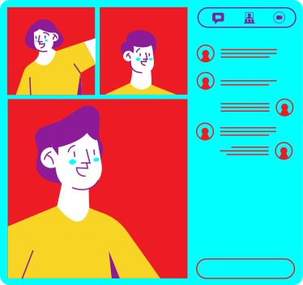
STEP 05
BUILD YOUR PERSONAL BRANDING
Create a channel to live stream while you're practicing. Professional esports teams can see your potential through channels or recommendations. One of them is that by establishing a positive image, you can go a step closer to becoming a professional game player.

Slide 9

ARE YOU READY FOR THE NEXT PRO GAME PLAYER?
KEEP PRACTICING,
DON'T GIVE UP

Slide 10

THANK YOU
I HOPE YOU LEARNED SOMETHING NEW!

